Slide 1






Department of Computer Science and Engineering
Data driven generalized approach for Distributed denial of service (DDoS) Detection using Long short-term memory (LSTM) algorithm
Team Members:
Guided by,
Ms.D.Vaitheeswari,
M.E ,
Asst.Professor CSE dept
Batch No: 14
Date : 24.05.2023
Ramyaa . M
113119UG03079
Monika . M
113119UG03059
Nivetha . D
113119UG03064
Renuka . R
113119UG03081

Slide 2
Objective
To develop a productive and embodied architecture.
To use the second derivative to minimize model error.
To ensure classification algorithms do not discriminate against protected groups.
To select weights from the distribution and scale the weight-dependent parameters accordingly.
Network security has become more important over the last decade due to the increasing number of new attack techniques being used against computer network.

Slide 3
Abstract
DDoS attacks also known as distributed denial of service (DDoS) attacks have emerged as one of the most serious and fastest-growing threats on the Internet. Denial-of-service (DDoS) attacks are an example of cyber-attacks that target a specific system or network in an attempt to render it inaccessible or unusable for a period of time. As a result improving the detection of diverse types of DDoS cyber threats with better algorithms and higher accuracy while keeping the computational cost under control has become the most significant component of detecting DDoS cyber threats.

Slide 4
PROBLEM STATEMENT
Network security has become more important over the last decade due to the increasing number of new attack techniques being used against computer networks.
Many of these attacks are attempts to compromise a computer network by overwhelming the network with information which can often lead to devices slowing down shutting down or opening the network to new vulnerabilities.
These types of attacks are commonly referred to as distributed denial-of-service attacks (DDoS) and the technique for generating this type of attack has been evolving for the past twenty years.

Slide 5
Proposed system
We leverage and propose a deep learning approach based on LSTM for detection of DDoS attacks on the SDN. We combine LSTM-CNN with softmax model at the output layer to classify the network traffic into malicious or normal.
The trained model behavior is directly controlled by the values of the hyper-parameters where selecting the best values plays a key role in the success of neural network architecture.
However selecting the best values of hyperparameters is still dependent on the best practice or human knowledge. The softmax layer takes the decoder output and classifies the input data into normal or attack traffic.

Slide 6
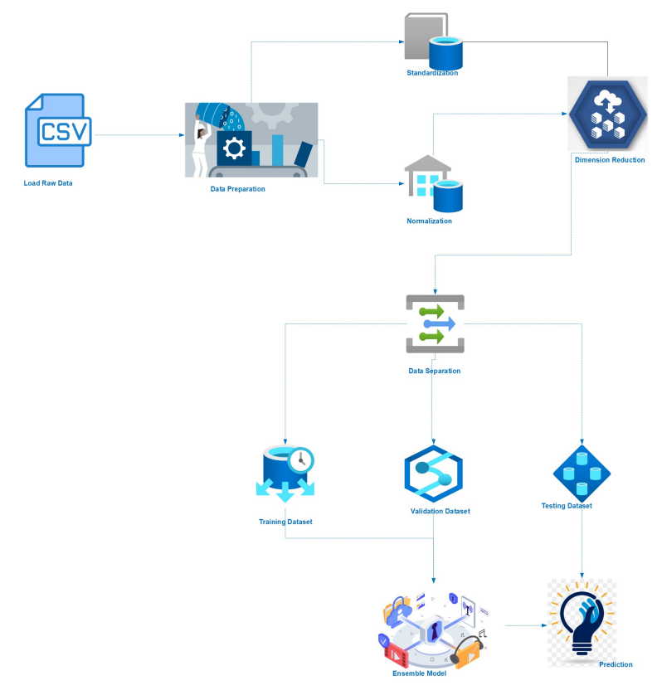
Architecture diagram

Slide 7
DATASET
Dataset URL: https://www.unb.ca/cic/datasets/ddos-.html
Dataset Description: Distributed Denial of Service (DDoS) attack is a menace to network security that aims at exhausting the target networks with malicious traffic. Although many statistical methods have been designed for concerns.

Slide 8
Existing System
Traditional attack detection approaches utilize predened databases of known signatures about already-seen tools and malicious activities observed in past cyber-attacks to detect future attacks.
More sophisticated approaches apply machine learning to detect abnormal behavior. Nevertheless, a growing number of successful attacks and the increasing ingenuity of attackers prove that these approaches are in-suffcient.

Slide 9
Disadvantages
Classification process consumes large amount of computational time.
Computationally intensive and require relatively large memory space
It is not an easy-to-use method
High complexity of installing and maintaining
Difficulties to obtain better performance just create a chatbot

Slide 10
Literature Survey
A Flexible SDN-Based Architecture for Identifying and Mitigating Low-Rate DDoS Attacks Using Machine Learning
While there have been extensive studies of denial of service (DoS) attacks and DDoS attack mitigation, such attacks remain challenging to mitigate. For example, Low-Rate DDoS (LR-DDoS) attacks are known to be difficult to detect, particularly in a software-defined network (SDN)..

Slide 11
Hybrid DDoS Detection Framework Using Matching Pursuit Algorithm
Although a considerable amount of research has been done on DDoS attacks, it still poses a severe threat to many businesses and internet service providers. DDoS attacks commonly generate a high amount of network traffic

Slide 12
Navleen Kaur, Dr Monika Sharma, Supriya Lamba Sahdev, Laraibe Siddiqui, "A Review of Chatbots in the Banking Sector",2020
The Artificial intelligence (AI), is simulation of human intelligence in machines. Artificial intelligence consists of generally two fundamental ideas. First it involves studying human brains like how their thought process works.

Slide 13
Advantages
Ability to process large amount of data quickly in order to detect attacks.
Better decision-making as to the training time.
Efficiently improve time efficiency involves the computation time and communication time Eliminating the huge workload of traditional methods Proving High Robustness and imperceptibility

Slide 14
Hardware Requirements
Processor : Minimum i3 Dual Core
Ethernet connection : (LAN) OR a wireless adapter (Wi-Fi)
Hard Drive : Minimum 100 GB; Recommended 200 GB
Memory(RAM) : Minimum 8 GB; Recommended 32 GB

Slide 15
Software Requirements
Software Tool : Anaconda
Operating System : Windows 10
Processors : Any Intel or AMD X86-64 processor
RAM : 2GB
Graphics Card : No Specific graphics card required

Slide 16
Algorithms
Long Short term memory algorithm :
LSTM stands for long short-term memory networks, used in the field of Deep Learning. It is a variety of recurrent neural networks (RNNs) that are capable of learning long-term dependenciy
Random forest algorithm:
Every decision tree has high variance, but when we combine all of them together in parallel then the resultant variance is low as each decision tree gets perfectly trained on that particular sample data,

Slide 17
Modules
Data Pre-processing
Feature Extraction
Model Training
Evaluation

Slide 18
Data Pre-Processing
The operation steps for data pre-processing :
Replacing null and infinite values
Removing remaining null values
Encoding categorical columns
Removing columns with zero variance
Removing columns with low correlation

Slide 19
Feature Extraction
Feature selection is used to reduce the number of variables and obtain a simpler model. It is an important pre-processing step in a number of machine learning applications. It employs a two-step process to extract numerical or categorical information (features) of the traffic observed, i.e., packet grouping and statistics computation.

Slide 20
Model Training
We split the dataset into three sections of training, validation, and testing subset. We build the model using the training set to adjust the weight on the neural network. The validation set is used to fine-tune the experiment parameters i.e. classifier architecture (not weights) like the number of hidden layers in the proposed model.

Slide 21
Evaluation
We focus on the following important performance indicators: false alarm rate (FAR), precision, F-score, detection rate (DR), recall, True Negative Rate (TNR), False Accept Rate (FAR), ROC Curve, and accuracy. We use the Receiver Operating Characteristic (ROC) curve to evaluate how well the model performs accurately

Slide 22
Future Enhancements
In the future we are interested in testing the performance of our proposed model on other datasets. In this current work we used a binary classification framework to classify the input traffic into normal and malicious types. However it is also necessary to classify each individual attack types separately. We intend to extend our work to a multi-class classification framework.

Slide 23
CONCLUSION
Network virtualization leads to new threats and new exploitable attacks that the ones already existing in the traditional network. The DDoS attack class is considered one of the most aggressive attack types in recent years causing a critical impact on the whole network system.The advent of ubiquitous network-based technologies has increased the associated vulnerabilities.The need for effective network protection tools have never been greater. In this paper we propose an AI-based IDS that is capable of distinguishing between regular and DDoS traffic

Slide 24
REFERENCES
[1] Johan Hagelbäck ,”Hybrid Pathﬁnding in StarCraft” in IEEE Transactions On Computational Intelligence and AI In Games,vol.8, no.4, December 2021.
[2] Serhij Lebedynskyj “Master’s Thesis” Methods of multiagent movement control and coordination of groups of mobile units in a real-time strategy games on Prague,2/2/21.
[3] Tung Nguyen, Kien Nguyen and Ruck Thawonmas “Potential Flow for Unit Positioning During Combat in StarCraft”, 2019

Slide 25
[4] J. Hagelbäck, “Potential-ﬁeld based navigation in StarCraft,” in Proc. IEEE Conf. Computat.Intell. Games (CIG),2019.
[5] Carl-Oscar Erneholm, “Simulation of the Flocking Behavior of Birds with the Boids Algorithm”, Bachelor’s Thesis in Computer Science in 2018.
[6]N. Z. Bawany, J. A. Shamsi, and K. Salah, DDoS attack detection and mitigation using SDN: Methods, practices, and solutions, Arabian J. Sci.

